Slide 1
Connext Command Response example highlights
RTI Runs a Smarter World
Paul Schmitt
RTI FAE New England; pschmitt@rti.com
Rev 1.2

Slide 2

Highlights (1/3)
Goal of project:
Create a simple example of a Command / Response Data Model
Morphed into:
Object oriented methods to Jump-start your customer using Connext using Multi-topic applications

Slide 3
Highlights Overview (2/3)
Examples Include:
C++11, Python w/XML Application Creation and Dynamic Data
Traditional C++ with programmatic entity creation and compiled Data types
Common code flow and project files across all examples
RTI System Designer and a Single Data-model
All examples use the same instantiated data-model & QoS libraries
All examples interoperate with each other
Objective State Command / Response Pattern
Object Oriented Code Factors-out and Encapsulates most DDS APIs from the user, allowing news users to jump-start their Connext Journey

Slide 4
Highlights Overview (3/3)
Supports
Periodic data writers
Use of a Content Filter Modifier Object to direct requests to specific device
Event Monitoring on all topics
Currently fixed default of monitoring pubs and subs
Use of waitsets and threading on all topics
Writers use threads for periodic topics or event monitoring
Optional listener for writer event monitoring only
Use RTI Code Generator for Type Support files, header files
Header file is used with XML Application Created Applications

Slide 5
Getting Setup
Defining your Application, Data Patterns and Data Model

Slide 6
Topic Handshake
Two Topics - DeviceState & ConfigureDevice
DEVICE
CONTROLLER
QoS - Durable
New Device Found (Uninitialized)
Device Status
(issue on change)
UNITIALIZED
(w/DeviceID)
QoS - Reliable
CFT (my device ID)
Receive Request and set Device to ON
Configure Device Request
ON
QoS - Durable
(TargetID)
Device (DeviceID) tracking to ON
Device Status
(issue on change)
ON
(w/DeviceID)

Slide 7
IDL (1/3)
Common
const uint32 LEN_DEVICE_ID = 32;
const uint32 LEN_STR_FOO = 10;
const uint32 LEN_STR_BAR = 16;
enum DeviceStateEnum {
UNINITIALIZED,
OFF,
ON,
ERROR
};
@nested
struct DeviceId {
int32 resourceId;
int32 id;
};
@nested
struct DeviceConfigurationStruct {
ExCmdRsp::DeviceStateEnum stateReq;
string<LEN_STR_FOO> fooName;
int32 fooValue;
string<LEN_STR_BAR> barName;
uint32 barValue;
};
Topics
typedef ExCmdRsp::DeviceConfigurationStruct DeviceConfiguration;
struct ConfigureDevice {
ExCmdRsp::DeviceId targetDeviceId;
ExCmdRsp::DeviceConfiguration deviceConfig;
};
struct DeviceState {
@key
ExCmdRsp::DeviceId myDeviceId;
ExCmdRsp::DeviceStateEnum state;
};
Notes:
If not using XML Application creation you only need to define the DataTypes (What) and QoS (How)

Slide 8
IDL (2/3)
Encapsulation of Naming Contained Within the XML
<const name="MODULE_EX_CMD_RSP" type="string" value="ExCmdRsp"/>
<const name="TYPE_CONFIGURE_DEVICE" type="string" value="ExCmdRsp::ConfigureDevice"/>
<const name="TOPIC_CONFIGURE_DEVICE" type="string" value="ConfigureDevice"/>
<const name="TOPIC_CONFIGURE_DEV_CFT" type="string" value="ConfigureDevice::MyFilter"/>
<const name="CONTROLLER1_PARTICIPANT" type="string" value="CmdRspParticipantLibrary::ControllerParticipant1"/>
<const name="DEVICE_STATE_READER" type="string" value="ControllerSubscriber::DeviceStateReader"/>
<const name="CONFIGURE_DEVICE_WRITER" type="string" value="ControllerPublisher::ConfigureDeviceWriter"/>
<const name="CONFIGURE_DEVICE_READER" type="string" value="CmdRspQoSLibrary"/>
<const name="DEVICE_STATE_TOPIC_QOS_PROFILE" type="string" value="DeviceStateProfile"/>
<const name="CONFIG_DEV_TOPIC_QOS_PROFILE" type="string" value="ConfigDevProfile"/>
Notes:
If not using XML Application creation you only need to define the DataTypes (What) and QoS (How)

Slide 9
IDL (3/3) Code Generated in .h/hpp files
static const std::string MODULE_EX_CMD_RSP = "ExCmdRsp";
static const std::string TYPE_CONFIGURE_DEVICE = "ExCmdRsp::ConfigureDevice";
static const std::string TOPIC_CONFIGURE_DEVICE = "ConfigureDevice";
static const std::string TOPIC_CONFIGURE_DEV_CFT = "ConfigureDevice::MyFilter";
static const std::string TYPE_DEVICE_STATE = "ExCmdRsp::DeviceState";
static const std::string TOPIC_DEVICE_STATE = "DeviceState";
static const std::string CONTROLLER1_PARTICIPANT = "CmdRspParticipantLibrary::ControllerParticipant1";
static const std::string DEVICE_STATE_READER = "ControllerSubscriber::DeviceStateReader";
static const std::string CONFIGURE_DEVICE_WRITER = "ControllerPublisher::ConfigureDeviceWriter";
static const std::string CMD_RSP_QOS_LIBRARY = "CmdRspQoSLibrary";
static const std::string DEVICE_STATE_TOPIC_QOS_PROFILE = "DeviceStateProfile";
static const std::string CONFIG_DEV_TOPIC_QOS_PROFILE = "ConfigDevProfile";
Notes:
If not using XML Application creation you only need to define the DataTypes (What) and QoS (How)

Slide 10
QoS Profiles
RTI Built-in profile used for each command
<qos_library name="CmdRspQoSLibrary">
<qos_profile name="DeviceStateProfile" base_name="BuiltinQosLib::Generic.KeepLastReliable.TransientLocal">
</qos_profile>
<qos_profile name="ConfigDevProfile" base_name="BuiltinQosLib::Generic.KeepLastReliable">
</qos_profile>
</qos_library>
In a more complex model, specific profiles are created and assigned to each command
Notes:
If not using XML Application creation you only need to define the DataTypes (What) and QoS (How)

Slide 11
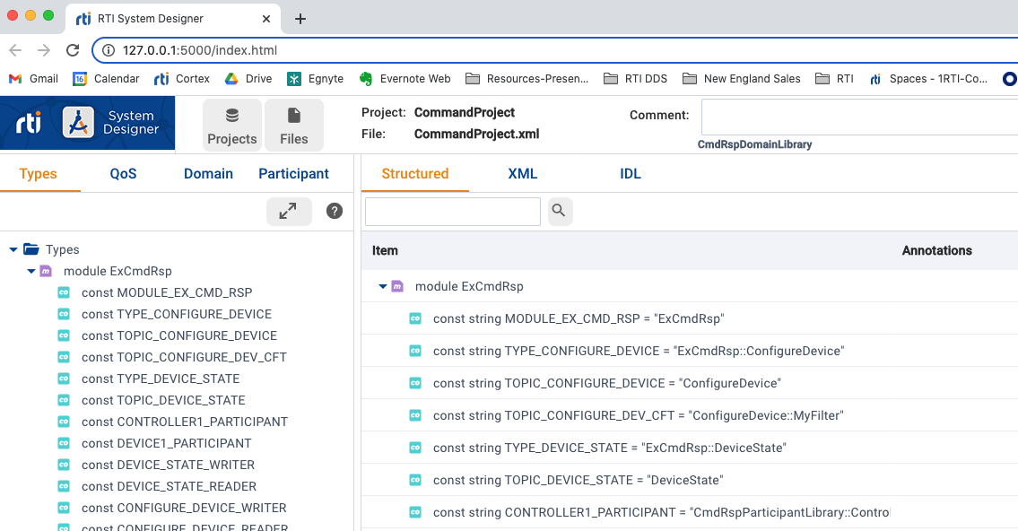
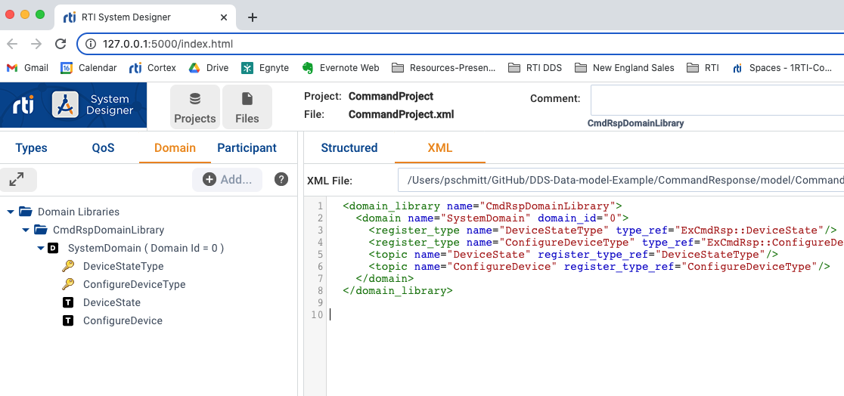
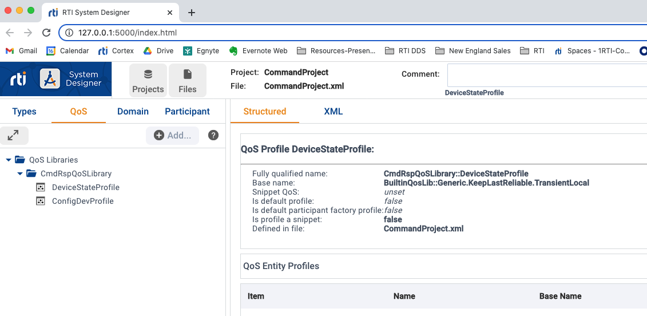
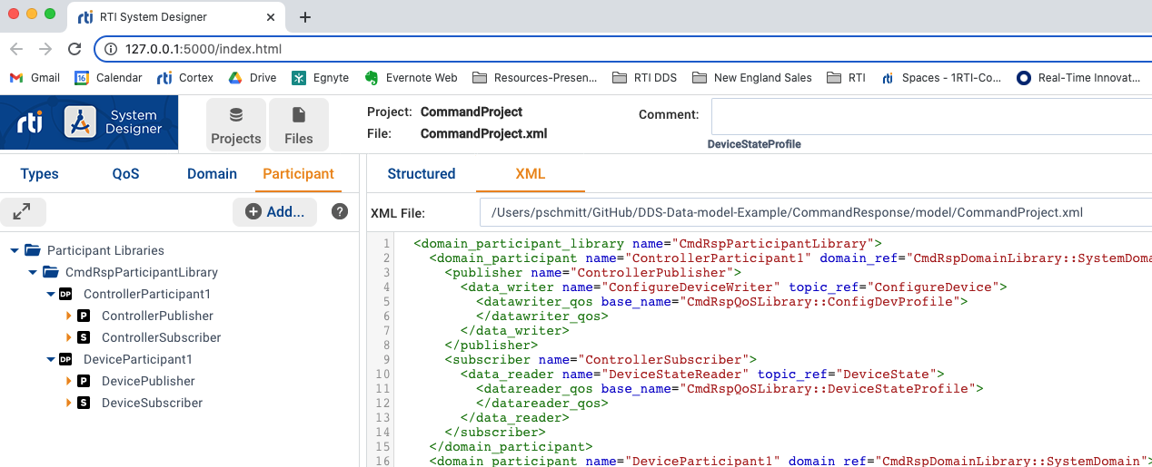
Define Your Data & System Model w/QoS
Used RTI’s System Designer to define the “What”, ”How” and ”Who” of the entire system:
Data Types / Topics via Domain Libraries (the “What”)
QoS libraries per command (the “How”)
Participant Libraries (the “Who”)
Encapsulate Topic Names, Type Names, QoS libraries and Entity Libraries as CONST in system designer
Notes:
If not using XML Application creation you only need to define the DataTypes (What) and QoS (How)

Slide 12
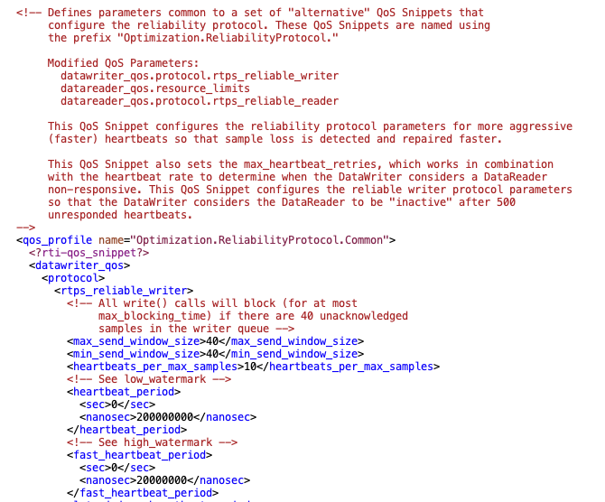
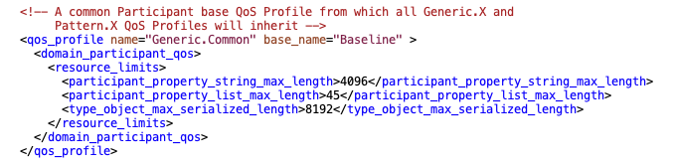
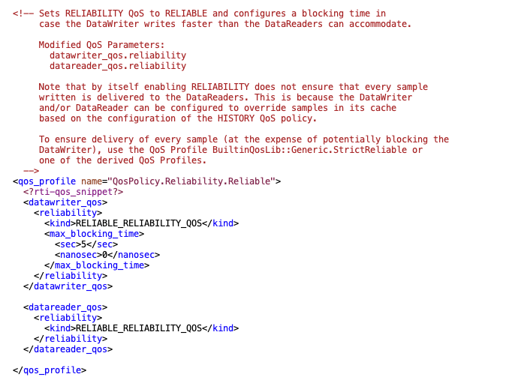
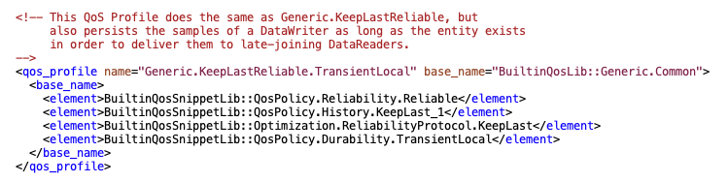
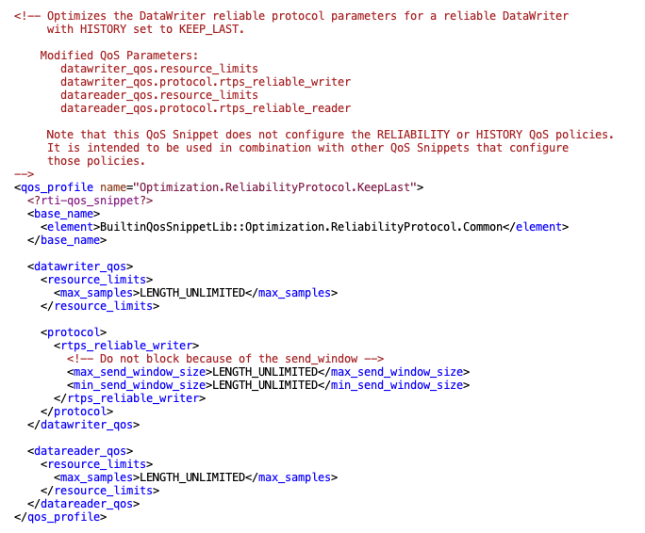
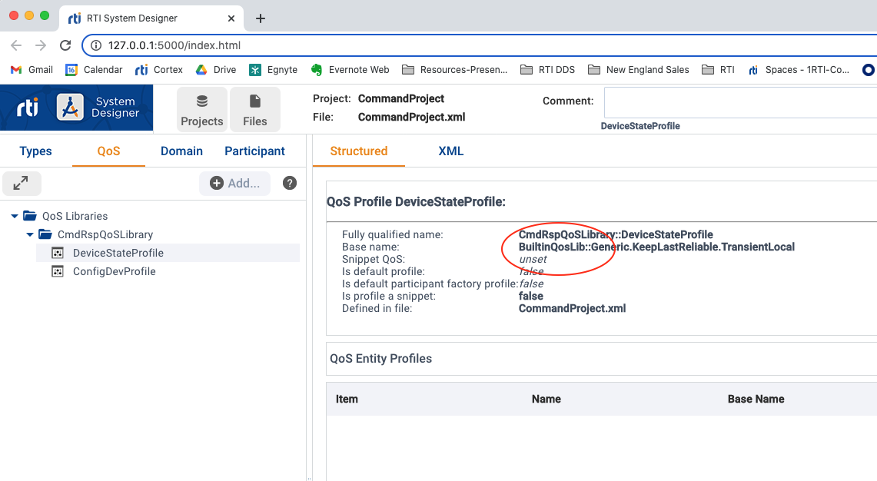
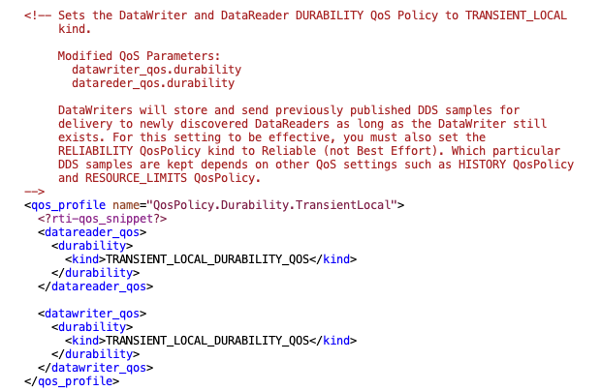
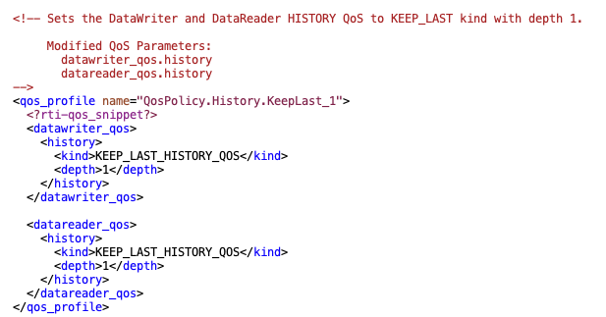
Simplify by using RTI’s Built-in QoS libraries
Defined in XML documentation file using Snippet Composition and Inheritance: (Encapsulated for you)

Slide 13
Jump-starting Connext using Object Oriented Design Patterns (XML Application Creation Version – C++11 and Python)
Simplified use for the user by factoring out and encapsulating most DDS calls

Slide 14
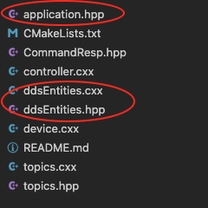
Example Project File Layout – Common files
Application.hpp (py)
Holds stop_handler() – Re: Control-C shutdown
ddsEntities.hpp and cxx (py)
Encapsulates Reader and Writer Activities
Forms your Reader / Writer topics base class
Identifies (Finds) associated topic reader or writer
Contains Default Event Monitoring
Optional Writer side Listener vs. Thread monitoring
Reader - Reads (takes) the sample
Dispatches to concrete class to put the sample in user topic context
Writer creates and holds sample to be modified and written
Dynamic Data APIs (2)
User only needs to overload writer() and reader handler() member functions to allow data to be handled in concrete topic class context
Implements threads and provides thread Management APIs
run()and getThreadHndl()
ddsEntity
Thread
DDS Databus
(Pub/sub)

Slide 15
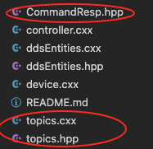
Example Project User Specific Topic Files
CommandResponse.hpp (constants.py)
RtiCodeGenerated Header file of your Data model/System model
Contains CONTS, ENUMS associated with the models
topics.hpp and cxx (.py)
Holds your application(s) topics inheriting from base entity reader and writer classes
Implements the base class virtual writer() and reader handler() member functions
User Extends the base Reader / Writer Entity Classes for application requirements
Default Event Monitoring
ddsEntity
Thread
DDS Databus
(Pub/sub)
Custom Event Monitoring
yourTopicWrt::Writer
youTopicRdr::Reader
CFT

Slide 16
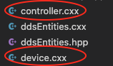
Example Project – Application Files
Device and Controller Applications (.cxx or .py)
Your Applications (complementary forms of each other)
Creates the Participant via XML Application Creation (from_config)
Instantiates your Topics (from topics.hpp)
Install optional Listener
Installs optional Content Filter
Example Runs the Application State Machine

Slide 17
How to Use this example (1/3)
Create / Design your Application
Use System Designer to define Types/Topics, QoS Libs, Domain Libs, Participant Libs
Best practice – run idl through rticodegen to create header file for use with your system and data model
python requires creating an equivalent of constants.py
Use Common files in your project
Application.hpp (optional), ddsEntity.hpp/cxx (required)
Create your own topic.hpp/cxx
Leverage example

Slide 18
How to Use this example (2/3)
Create your own topic.hpp/cxx (con’t)
Create topic readers and writers inheriting from reader or writer base class (w/correct parameters)
: Reader(participant, MODULE::TYPE_DEVICE_STATE, MODULE::DEVICE_STATE_READER)
: Writer(participant, MODULE::TYPE_DEVICE_STATE, MODULE::DEVICE_STATE_WRITER, periodic, period)
Writers – override virtual function writer()to update sample in topic context
Concrete class writer() requires a “Downcast / transfer” function – example:
// write() is effectively a runtime down cast for periodic data
void write() {
this->writeData(this->getCurrentState());
}
The writeData() function must also be added Topic::write class.
It can be any name with any data to write

Slide 19
How to Use this example (3/3)
Readers – override virtual function handler() to allow the base class to call the read handler to received data in topic context.
If required - Create our own ”updateCft()”
name is unimportant
Best Practice – Create a Generic CFT in the System Designer XML and populate it programmatically
Each device plugs in its own Device ID filter vs. Creating multiple XML CFTs
<content_filter name="MyFilter" kind="builtin.sql">
<expression>targetDeviceId.resourceId = %0, targetDeviceId.id=%1</expression>
<expression_parameters>
<element>0</element>
<element>0</element>
</expression_parameters>
</content_filter>

Slide 20
Example Application flow (1/2)
This will of course be dependent upon your application, but many of the steps should be similar
Point to the xml file and stand-up participant and all entities
Best practice to keep the xml file in a “model or system designer” directory of some kind.
dds::core::QosProvider qos_provider({ MODULE::QOS_FILE });
dds::domain::DomainParticipant participant =
qos_provider->create_participant_from_config(MODULE::DEVICE1_PARTICIPANT);
“Create” writer and reader topics
Note: These are already created via the xml file in the step above. The base class simply “finds” them as you’ve provided the required parameters in your topics.cxx class constructor
Start the thread on readers and writers
Optionally install a listener on writers

Slide 21
Example Application flow (2/2)
Update any content filter parameters
Note Content filters w/expression are installed via the associated XML based QoS library
Run your Applications State Machine
Upon shutdown
Join any threads via getThreadHndl() api

Slide 22
ToDo: (enhancements)
Allow Reader Event Monitors to be customized
Reader event monitoring is done in the reader thread since we have to wait for data_available anyway.
Add RTI Logger Objects to Entity base classes

Slide 23
Jump-starting Connext using Object Oriented Design Patterns (Programmatic and compiled Types Version – C++)
Simplified use for the user by factoring out and encapsulating most DDS calls

Slide 24
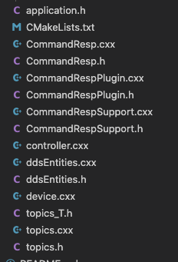
Example Project File Layout – Common files
With noted exceptions explained here, the flow is the same, to the XML Application Creation previously described.
Entities are created vs. found
This is hidden from the user
Compiled types are used so, in order to maintain the encapsulation, type specific template Topic classes are used between the user topics and ddsEntity.h and cxx files
This is almost hidden from the user
User has to hand in the Type <T>
All of the RtiCodeGen type specific Support files are required
Content filters are created, so a Cft Object has been provided
ddsEntity
Thread
DDS Databus
(Pub/sub)
CFT Object
Topics_T.h

Slide 25
Overview of Template Classes
Template<Typename T>
class Add {
Private:
T num1; T num2;
public:
Add (T x, T y) { // c’tor
num1 = x;
num2 = y;
}
T add() {return num1 + num2; }
void displayResult() {
cout << “Numbers: “ << num1 << “ and ” << num2 << “.” << endl;
cout << num” << “ + “ << num2 << “ = “ << add() << endl;
}
}
Int main() {
Add<int> intAdd(2, 1);
Add<float> floatAdd(2.4, 1.2);
cout << “Int Results:” << endl;
intAdd.displayResults();
cout << “float Results:” << endl;
floatAdd.displayResults();
Return 0;
}
Templates factor out business logic Type independently.
The Logic is written once. The class is instantiated for each Type defined
Example:

Slide 26
Example Project User Specific Topic Files
Almost Identical to XML Application Creation above except you hand in the required Type <T> Info
// T is the Topic e.g. DeviceState
// S is the TopicTypeSupport e.g. DeviceStatusTypeSupport
// R is the Reader for the specific topic - e.g. DeviceStateReader
// D is the Topic - Topic Data Sequence e.g. DeviceStateSeq
template<typename T, class S, typename R, typename D>
class TopicRdr : public Reader {
Example Specific Topic Use
class DeviceStateRdr : public TopicRdr<
MODULE::DeviceState,
MODULE::DeviceStateTypeSupport,
MODULE::DeviceStateDataReader,
MODULE::DeviceStateSeq> {
public:
DeviceStateRdr(const DDSDomainParticipant * participant, const DDSSubscriber * subscriber, const Cft filter) :
Default Event Monitoring
ddsEntity
Thread
DDS Databus
(Pub/sub)
Topics_T.h
Custom Event Monitoring
yourTopicWrt::TopicWtr<T>::Writer
youTopicRdrTopicRdr<T>::Reader
CFT

Slide 27
Example Application flow (1/3)
Again, this will of course be dependent upon your application, but many of the steps should be similar AND similar to the XML Application example above
Point to the xml file and create participant
Best practice to keep the xml file in a “model or system designer” directory of some kind.
const char *url_profiles[1] = { QOS_FILE };
DDS_DomainParticipantFactoryQos factory_qos;
DDSTheParticipantFactory->get_qos(factory_qos);
factory_qos.profile.url_profile.from_array(url_profiles, 1);
DDSTheParticipantFactory->set_qos(factory_qos);
DDSDomainParticipant * participant =
DDSTheParticipantFactory->create_participant(
domain_id,
DDS_PARTICIPANT_QOS_DEFAULT,
NULL /* listener */,
DDS_STATUS_MASK_NONE);

Slide 28
Example Application flow (2/3)
Create Subscriber and Publisher Container Objects
DDSSubscriber * subscriber = participant->
create_subscriber(
DDS_SUBSCRIBER_QOS_DEFAULT,
NULL /* listener */,
DDS_STATUS_MASK_NONE);
DDSPublisher * publisher = participant->
create_publisher(
DDS_PUBLISHER_QOS_DEFAULT,
NULL /* listener */,
DDS_STATUS_MASK_NONE);

Slide 29
Example Application flow (3/3)
Other than using the CFT object (initializing it with the param_list and expression string), the rest of the example is very similar to the C++11 and Python examples / XML Application Creation/Dynamic Data
std::string s1 = std::to_string(device_state_writer.getTopicSample()-> myDeviceId.resourceId);
std::string s2 = std::to_string(device_state_writer.getTopicSample()-> myDeviceId.id);
const char *param_list[] = { s1.c_str(), s2.c_str(), NULL };
// create a filter for the ConfigureDeviceReader Cft cdr_cft(param_list, "targetDeviceId.resourceId = %0, targetDeviceId.id=%1" );

Slide 30
Lessons Learned

Slide 31
Compiled Types vs. Dynamic Types
Really like use of Dynamic Data over Compiled Types
Entity handles are type agnostic
Simplified inheritance structure and template use required of compiled types

Slide 32
Code Available
Zip available from MyGoogleDrive-CommandResponseProject
(https://drive.google.com/drive/folders/1XSN-iqrcOXqouQDHt1Ff6EIDUZn_pVC6)

Slide 33
Thank You!
Paul Schmitt

